Slide 1
2023-2024 Dual Enrollment Information Night
Presented by MHS Counseling on 1/18/2024

Slide 2
What is dual enrollment?
Provides funding for students enrolled at eligible high schools to attend Georgia colleges, universities and technical schools and take approved college-level coursework for credit towards both high school and college graduation requirements.
Participants must meet admission requirements for the individual institution for which they wish to enroll.
Offered during Summer, Fall, and Spring terms.
Common Dual Enrollment Acronyms
DE: Dual Enrollment
USG: University System of Georgia
TCSG: Technical College System of Georgia
GSU: Georgia State University
GTC: Gwinnett Technical College
GT: Georgia Tech
SAP: Satisfactory Academic Progress
W: Withdrawn

Slide 3
Dual enrollment fit
Students considered a good fit for DE are:
Mature
Organized
Responsible
Self-Motivated
On track for graduation
Students considered a good fit for DE can:
Take initiative
Communicate with adults independently without parent support
Check email regularly and able to manage two schedules (high school and college)
Keep up with their plan for DE coursework fitting into the HS 4-year plan
Work ahead to meet deadlines successfully
Overcome any logistical challenges of traveling to and from the local high school and college
If you (the parent) are completing any paperwork, applications, or sending materials on behalf of your student, this is a strong indicator that Dual Enrollment is NOT a good fit for your student yet.
Students prepared for taking this next step should be able to read through directions and complete this process independently.

Slide 4
Dual enrollment options
Full-Time DE Student:
At least 4 college courses, totaling 12-15 college credit hours per semester.
All classes are taken on the college campus or online.
No courses would be taken at MHS.
Student is still enrolled at MHS and is fully eligible to participate in clubs, extracurricular activities, sports, and events.
Part-Time DE Student:
Fewer than 12 College Credit Hours.
Must be enrolled in 6 courses between MHS and the college (FCS now allows 5 courses total for Seniors on-track for graduation).
Needs to coordinate DE courses with periods MHS classes are offered.
Allow for SAFE driving time between MHS and the college.
Not allowed to enter/exit MHS’ campus multiple times a day.

Slide 5
Dual enrollment general information
Students in grades 10-12 are eligible to participate.
Colleges may have specific age requirements.
Once a student graduates they are no longer eligible.
There is no Credit Recovery for College Classes.
Can participate in Fall, Spring, and Summer terms.
Fulton County Schools maintains TWO deadlines for declaring participation:
Summer and Fall: March 29th
Spring Only: November 1st
FERPA Laws are different for High Schools and Colleges.
ALL communication goes through the student.
Students with IEP or 504 accommodations must contact their college to request appropriate accommodations.
A maximum of 15 credit hours per term allowed for funding.

Slide 6
Dual enrollment general information
Each college can maintain their own deadlines, qualifications for admissions, institution specific guidelines, etc.
Example: Orientation, Institution Holds, FERPA Waivers, Picking up & Returning books.
MHS is not responsible for overcoming logistics matters for students, or for ensuring students meet communicated dates and deadlines (including taking final exams).
If students have specific questions related to their application, college courses, etc. - they need to contact the college.
Students can only participate in dual enrollment at colleges/universities that agree to participate. Full List on www.GAFutures.org
Due to our geographic location, MHS students mainly participate in the Dual Enrollment Programs at Georgia State University Perimeter College, Gwinnett Tech, and Georgia Tech Distance Math.
We’ve had a few full time DE students attend KSU and UNG.
Students can only take approved coursework for each institution.
Dual Enrollment Course Directory

Slide 7
DE grading / credits / weight / withdrawals
Colleges assign letter grades and FCS converts them to numeric averages.
FCS adds 7 honors points to the final passing college course grades.
HOPE Scholarship: Core DE courses receive a 0.5 weight up to a maximum 4.0 and count as academic rigor.
Final grades for all DE courses will be posted on the HS Transcript. If a student withdraws from a course and does not transfer/enroll in another course at the college or HS, he/she will receive a “W” as a final mark on their HS Transcript. The “W” does not earn HS credit nor does it hurt the GPA.
DE Course Credit:
1-2 Semester Credit Hours = 0.5 High School Credit
3-5 Semester Credit Hours = 1.0 High School Credit
Example: ENGL 1101 is a 3-credit hour course at the college. Therefore, completion of ENGL 1101 would earn 1.0 High School Credit and earn the 4th English requirement for graduation.
Grade Posted to College Transcript | FCS Earned Grade | Grade Posted to HS Transcript
A | 95 | 102
B | 85 | 92
C | 75 | 82
D | 70 | 77
F | 60 | 60
WF | 60 | 60

Slide 8
Satisfactory academic progress (SAP)
Students must maintain SAP as defined by their selected institution to remain eligible to participate in the DE program.
A common requirement of meeting SAP is maintaining a college GPA of 2.0 or higher each semester. Students are responsible for checking with the selected institution to confirm requirements.
Students found ineligible to continue in DE will be required to return to the high school the following semester and their graduation status may be at risk.
If you don’t do well enough in your classes, colleges may require you to withdraw at the end of the semester if you’re not meeting their SAP policy.

Slide 9
Dual enrollment considerations
Potential to earn college credit:
Be sure to check the specific Colleges/Universities you are applying to for transferability.
Some schools may not accept all—or any—of the credits you’ve earned.
Be sure to contact the college you’ll be attending (or the colleges to which you are applying) and ask about their policies.
Some basic college classes may not be viewed as rigorously as an AP class:
In some instances, it’s better for a student to stay in AP courses to remain competitive in an applicant pool for admissions to some colleges.
Contact the college for recommendations.
Every student’s academic path is unique.
Earn 1.0 High School credit for each DE class you take.
Get first-hand idea of what's required of attending college.
If you already have a busy and stressful schedule, the additional requirements of DE could cause your grades to suffer and defeat its own purpose.
The courses you take in DE are real college courses—meaning they’ll go on your college transcript and stay there forever. You need to feel confident that you’ll be able to do well.
The schedule may not work with the classes you take at MHS, resulting in a student not being able to participate.

Slide 10
Dual enrollment = two schedules
Schedule #1 is your HIGH SCHOOL SCHEDULE
In the Spring, students identify projected courses of interest – both HS and DE. Once a student returns completed FCS contract, sends HS transcript, sends test scores, provides proof of college application, and completes their Advisement Form, DE course placeholder(s) will then be added to their MHS schedule.
Example: DELAPENDAccept&Reg AM = Pending an ELA DE course in the morning half of your day
Students must provide their college course schedule to their assigned counselor to get the DE course placeholder off their schedule prior to Friday, August 2, 2024. Placeholders listed on the MHS schedule will then be replaced with the appropriate DE course number/title.
Example: College Adv Comp = ENGL 1101
Having a DE course placeholder on your MHS schedule does not mean you are registered for the class!
Students MUST be accepted by the college and register for their DE courses with the college on their own.
Schedule #2 is your COLLEGE SCHEDULE
After meeting college specific requirements for registration (example: attend orientation), students must register for the college classes listed on the Advisement Form. If the student needs to update their Advisement Form, they must contact their counselor and let her know. Failure to report any course registration different than what’s listed on your SPA form may result in the COLLEGE removing you from the course.
The student is required to provide a copy of their college schedule to their assigned counselor so that their MHS schedule can be updated with the correct DE courses.
The FCS deadline to register for college courses and submit a copy of your college schedule to your counselor is Friday, August 2, 2024. Students that fail to meet this deadline will be placed in MHS courses for the first day of school on August 5, 2024.

Slide 11
De participation – roles & responsibilities
Student Role(s)
Applying to the college.
Submit all paperwork by the FCS deadline.
Submitting all required documents to complete college application file for admission.
Communicating acceptance/denial to your assigned counselor.
Set up meeting with assigned counselor to determine remaining courses for graduation and to complete the Advisement Form.
Attend college orientation.
Set up and check college email account daily.
Register for college courses agreed upon with your counselor & listed on your Advisement Form.
Complete dual enrollment funding application on www.GAFutures.org
Work with the college to secure FERPA waivers or services for students with disabilities if applicable.
Provide your assigned counselor with a copy of your schedule before August 2nd to finalize your high school schedule with correct courses.
Note- students that do not meet this deadline will be rescheduled for local high school courses.
Follow the college class schedule for attendance, testing, etc.
Follow any additional directions from the college.
Counselor Role(s)
Communicate dual enrollment opportunities to students and parents in multiple methods.
Provide academic advisement to the student and answer parent questions as needed throughout the process.
Sign Advisement Form, FCS Dual Enrollment Contract, and complete Dual Enrollment Funding Application (counselor portion) after the student submits the application on www.GAFutures.org
Ensure the student high school schedule is finalized by August 2nd to include accurate college courses the student is registered for and local high school courses.

Slide 12
Items that Mhs counselors do not manage
College Schedule and Course Availability
It is your responsibility to ensure you are at your college exams on the date and time outlined in your syllabus. Courses taken online may still require a face-to-face exam, so please mark your calendars and plan accordingly.
College breaks/holidays are different than those outlined by FCS.
College classes are not always offered at times that align with MHS’ schedule. Additionally, popular course times fill up quickly.
Acceptance Process
Students should contact the DE Office at the college.
Troubleshooting Holds on Admissions or Registration
Students should the contact the DE Office at the college to clear holds and/or troubleshoot any registration questions.
Communicating between you and the college about individualized situations (example: an absence, textbooks, a missed quiz, etc.)
Your Counselor is here to advise and support your Dual Enrollment participation process, but it is important to remember that you will be an independent college student while you are still in high school and must meet the same expectations of an undergraduate student.

Slide 13
Critically important
ALWAYS check your COLLEGE EMAIL ACCOUNT
Once accepted, communication between the college and DE student is primarily done via email. We HIGHLY recommend that you forward your college email to one that you check REGULARLY.
Check personal email account regularly
Communication between the MHS DE Coordinator is primary done via email.
STUDENTS should complete the application process themselves.
Communicate directly with the college with questions about DE application, registration, classes, grades, textbooks, etc.
CLEAR your account HOLDS!
Communicate any/all college schedule changes to your counselor. The counselor must be updated with all changes, every time!
Dropping a course: Please gain MHS counselor approval prior to dropping.
If college issues you a W for the course, so will MHS on your transcript.
Be sure all forms are completed correctly and completely.
Pay attention to and meet all deadlines for both the college, high school, and Fulton County - they are final. Try to work ahead of deadlines if possible!
Set a GOAL to be registered for your college courses and share your schedule with your counselor before we’re out for summer break!

Slide 14
Tips for selecting courses
College Prerequisites listed in the Dual Enrollment Course Directory should be consulted.
NOTE: Courses listed in the DE Course Directory are approved for state funding. Students will still need to refer to the college’s schedule of courses to determine if the course is offered at the GSU Alpharetta Campus or the GTC Alpharetta Campus.
GATRACS helps students identify courses that will transfer in Georgia.
Students planning to attend a USG institution following high school graduation should consult the USG’s Staying on Course document to ensure the USG’s Required High School Curriculum (RHSC) is completed.
Students starting at a TCSG institution with plans to transfer to a USG institution should consult the TCSG-USG General Education Transfer Chart.

Slide 15
What courses can students take to meet graduation requirements?

Slide 16
ELA
9th Grade Literature cannot be replaced by a college course and must be taken as a high school course.
American Literature can be substituted with College American Lit, but it will be out of sequence:
Why? Because of College Prerequisites. ENGL 1101, ENGL 1102, then American Lit
Students taking College American Lit are still required to take the 11th American Lit EOC.
Students taking the AP Lang exam must send their AP scores to the college to waive ENGL 1101:
Check with colleges on what type of score will earn credit.
AP scores can be sent to the college during the AP exam (this will automatically send your scores to the DE college without you seeing them first)
This is a race against time: ENGL 1102 courses may fill up before the college processes your ENGL 1101 waiver.

Slide 17
Math
Most restrictive subject area.
Students must take Algebra 1 C&C, Geometry C&C, and Advanced Algebra C&C BEFORE they can take college level math courses.
College Algebra is NOT Advanced Algebra C&C. College Algebra can count as a 4th math (like Pre-Calc, AMDM, etc.)
Students should ensure the math course or courses are appropriate for projected post-secondary major and qualifying for admissions to targeted colleges and universities.
Students can take math placements tests at the college to enter higher level math courses.

Slide 18
science
All Science graduation requirements can be taken through DE.
Courses cannot be duplicated unless there is a different course number in the DE Course Catalog (must have an alternate option, i.e. a HS course # with a letter in it)
Cannot take HS Biology in 9th grade and then College Biology later on if the course number is not different.
Students must take science courses that align with FCS graduation requirements (Biology, Physical Science/Physics, and approved 3rd and 4th Science Courses).
Students taking College Biology are still required to take the Biology EOC if they never took it in 9th grade.

Slide 19
Social studies
All SS graduation requirements can be taken through DE:
World History
US History
American Government
Economics
Courses cannot be duplicated unless there is a different course number listed in the Dual Enrollment Course Directory.
Students take Social Studies courses that align with Fulton County Schools graduation requirements:
American Government, Economics, World History, US History.
Other DE Social Studies courses can be taken but will only count as an elective.

Slide 20
electives
Students can take approved courses, such as Fine Arts, World Language, and CTAE courses to meet the 3 required Fine Arts/World Language/CATE credits for graduation.
Select courses that align with post-secondary goals.
Student should verify they meet pre-requisites for course registration - see DE Course Catalog.
PE Courses are no longer funded through the Dual Enrollment program.

Slide 21
Most popular choices at milton
College English
American Government
Economics (Global, Micro, Macro)
Psychology
Sociology
US History
College Algebra
Other Various Electives (Philosophy, Geography, Astronomy, Media/Culture/Society)

Slide 22
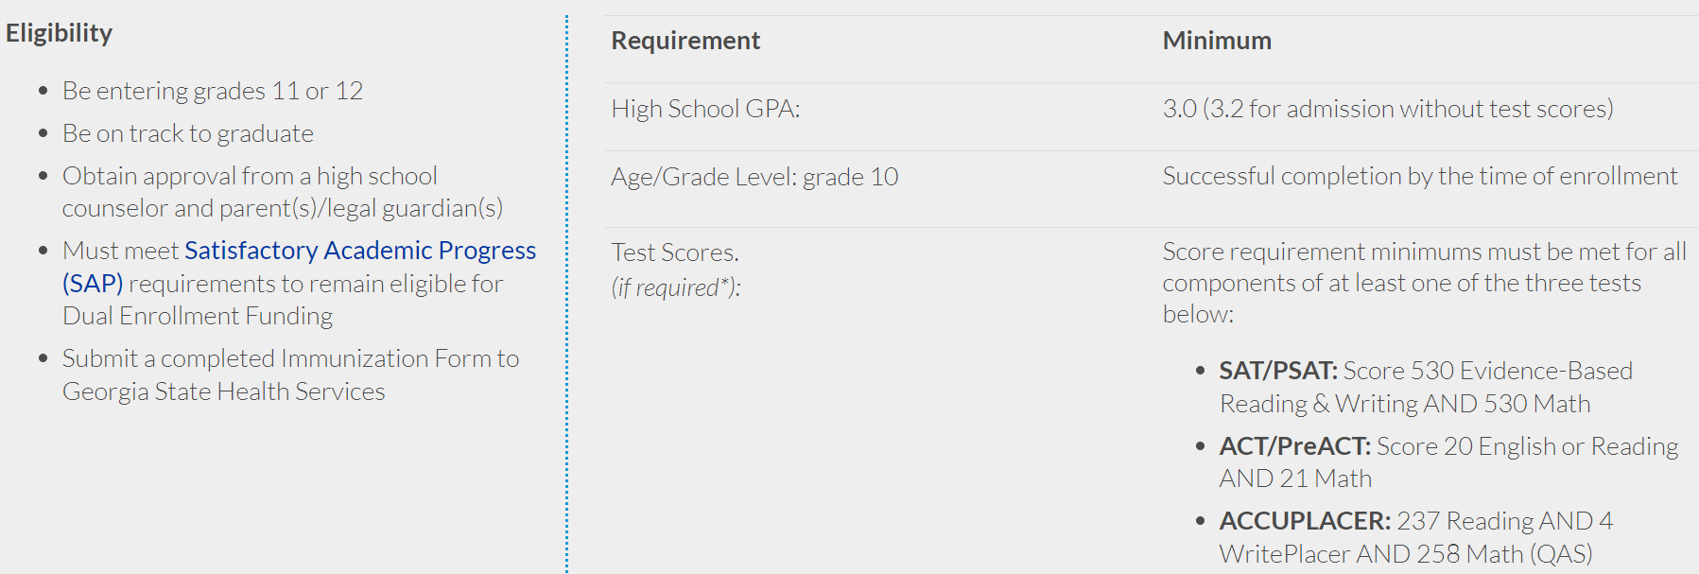
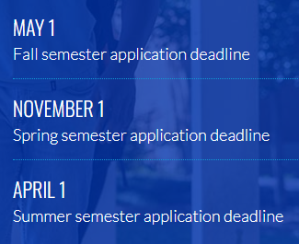
Dual enrollment optionS – Georgia state
Key Points to consider:
GSU can take up to 21 days to give an admissions decision
DO NOT wait until May 1 to apply for Fall
The earlier you complete this process, the sooner you have orientation, can register, and have the best course time selection available to you!
Do your research:
https://success.students.gsu.edu/dual-enrollment/future-students/

Slide 23
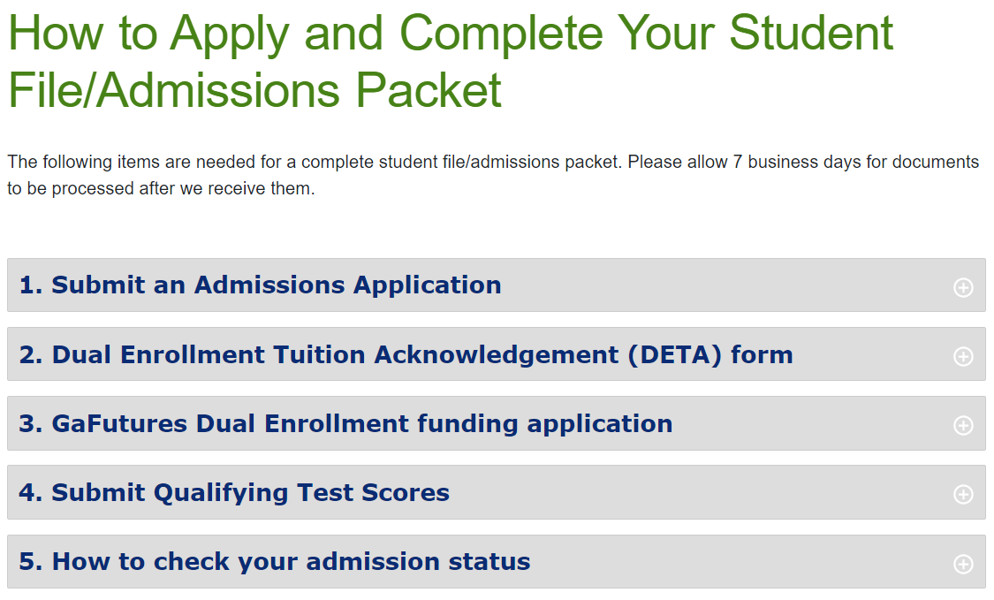
Dual enrollment optionS – gwinnett tech
Key Points to consider:
GTC has a quicker turnover for admission decision
They accept PSAT Scores as well as SAT/ACT for admission
Do your research:
https://gwinnetttech.edu/dualenrollment/participate/

Slide 24
Dual enrollment options – Kennesaw
Do your research:
https://www.kennesaw.edu/admissions/undergraduate/admission-requirements/dual-enrollment.php
Key Points to consider:
KSU has EARLY deadlines
Great college, but DE program can be difficult to navigate compared to GSU or GTC

Slide 25
Dual enrollment options – Georgia Tech
Georgia Tech Distance Math Year 1:
MATH 1554: Linear Algebra (Fall)
MATH 2551: Multivariable Calculus (Spring)
Georgia Tech Distance Math Year 2:
MATH 3012: Applied Combinatorics (Fall)
MATH 2552: Differential Equations (Spring)
Georgia Tech Computer Science:
CS 1301: Introduction to Computing
CS 1331: Introduction to Object-Oriented Programming with Java
All exams are taken at MHS.
ADDITIONAL academic requirements on the GA Tech website
Application dates are different for GT:
Window to apply for SUMMER is March 1-March 31
Window to apply for FALL is May 15-June 15
Window to apply for SPRING is September 15-October 25
DE Summer Counselor will work with these students through summer, but FCS paperwork is STILL DUE MARCH 29.
Qualifying Score on AP Calculus BC Exam is required for admission.
Do your research: https://admission.gatech.edu/dual-enrollment/

Slide 26
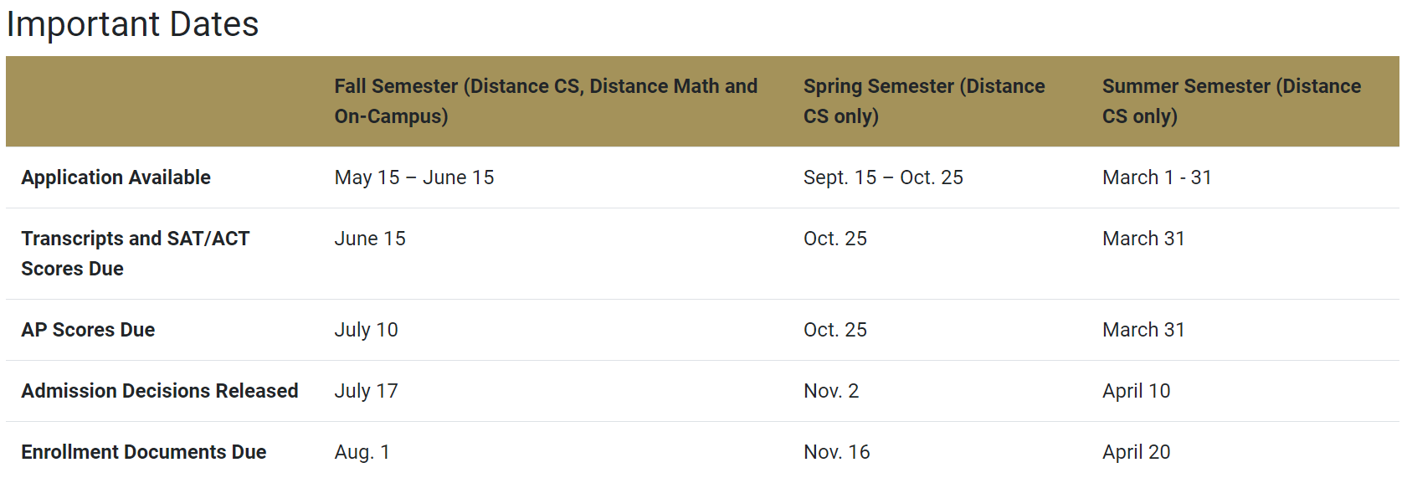
Dual enrollment options – Georgia Tech

Slide 27
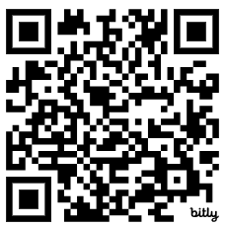
Dual enrollment options – auburn first
If you are interested in applying to Auburn First, please adhere to the college deadlines below:
Deadline to Apply for SUMMER 2024 = March 31, 2024
Deadline to Apply for FALL 2024 = March 31, 2024
To receive the most up-to-date information on the Auburn First Program, visit their website: aub.ie/auburnfirst
Additional Resources:
Read about the program here: https://www.auburn.edu/academic/provost/pathways/auburn-first/
Their program is evolving- make sure you know your requirements: https://www.auburn.edu/academic/provost/pathways/auburn-first/program-details/index.php
Scan the QR Code to access FAQs for Auburn First!

Slide 28
resources
www.miltoncounseling.org > Academic Advisement > Dual Enrollment Page
TCSG Dual Enrollment Site
https://tcsg.edu/dual-enrollment/
GaFutures
https://www.gafutures.org/
GADOE DE Information
http://www.gadoe.org/Curriculum-Instruction-and-Assessment/CTAE/Pages/Transition-Career-Partnerships.aspx
USG Site for Transfer Students
https://www.usg.edu/student_affairs/prospective_students/transfer
GATRACS
https://www.gatracs.org/
USG Staying on Course Document(lists required classes for freshmen 4 yr college admission)
https://www.usg.edu/assets/student_affairs/documents/Staying_on_Course.pdf

Slide 29
Contact us
Starting today, you can reach out to your assigned counselor with questions about Dual Enrollment, application/paperwork processes, and more!
Mrs. Casey Lahman, Last Names A-Cor, LahmanC@fultonschools.org
Ms. Christine Hoglander, Last Names Cos-Hok, HoglanderC@fultonschools.org
Ms. Renee Bartley, Last Names Hol-Mc, Bartley@fultonschools.org
Ms. Anna Rhodes, Last Names Md-San, RhodesA2@fultonschools.org
Ms. Blaze Wilson, Last Names Sao-Z, WilsonB@fultonschools.org
Mrs. Tiffany Harrison, Head Counselor, HarrisonT3@fultonschools.org

